Slide 1
Effective Advocacy Skill Building for Public Policy Change on Issues of Hunger and Poverty
Kelly Ault, Public Engagement Director
vermontearlychildhoodalliance.org * 802-229-4281 * a program of the VT Community Loan Fund

Slide 2
The Vermont Early Childhood Alliance is a statewide, independent, advocacy coalition formed in 2000 to bring together the early childhood community on policy priorities in the areas of health, safety, food, economic security and early care and education.
The Alliance’s goal is to support professionals, service providers, parents, teachers and employers in:
Becoming more informed on policy issues and being more effective in delivering messages;
Build relationships with legislators and administrative officials and increase their comfort level in talking with them; and
Seek opportunities for ongoing contacts with policymakers and influence them at key times during the decision making process.

Slide 3
Session Outline – Key Topics
Reviewing 2016 legislative issues relating to hunger and poverty
Understanding the world of the Vermont Legislature and Administration
Cultivating techniques for effective citizen advocacy in the State House and in the community
Moving from “constituent” to “advocate” in order to influence policy change
Looking ahead to 2017. Let’s work together!

Slide 4
Introduction to Advocacy
What is advocacy?
Assess your advocacy experiences:
Do you know your legislator or a “regulator”? Have you ever talked to them about an issue you care about?
Describe an experience you’ve had advocating for something.

Slide 5
Why Should You Care?
Many decisions made by legislators and regulators affect your day-to-day work in communities:
Issues related to nutrition & agriculture, early childhood, workforce development
Budget/revenue decisions
Many anti-hunger and anti-poverty organizations are committed to working in the policy arena:
System-wide policy change is part of mission
Taking positions on policy and developing policy platforms
Staff presence in the State House, giving testimony in Legislative Committees. Staff and clients contacting their legislators about bills and budgets
Joining other coalitions and campaigns

Slide 6
2016 Anti-Hunger & Anti-Poverty Issues
Vermont Foodbank:
Federal and Vermont programs, policies, funding and tax issues that address food insecurity and food safety
Livable wage benefits (Paid Sick Days bill, H.187).
Hunger Free Vermont:
Oral Health bill, S.20, expanding access to oral health care by allowing dental therapists to practice in Vermont.
Farm to School bill, S.169, expanding grant program to include child care providers and support schools in increasing participation in child nutrition through universal school meals.
Governor’s Council on Pathways from Poverty:
Funding for economic safety net programs, including affordable housing, child care, 3squares, AHS IT infrastructure, among others.

Slide 7
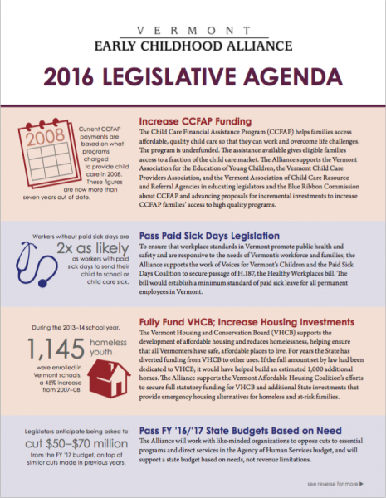
How is Early Childhood Faring in 2016?
Child Care Financial Assistance Program
Paid Sick Days
Affordable, safe and stable housing and programs that reduce homelessness
Vermont’s Fiscal Year 2017 State Budget
Special education
Quality afterschool and summer learning programs
State information technology
Child protection

Slide 8
Policymaking 101: Vermont Legislature’s Small Districts

Slide 9
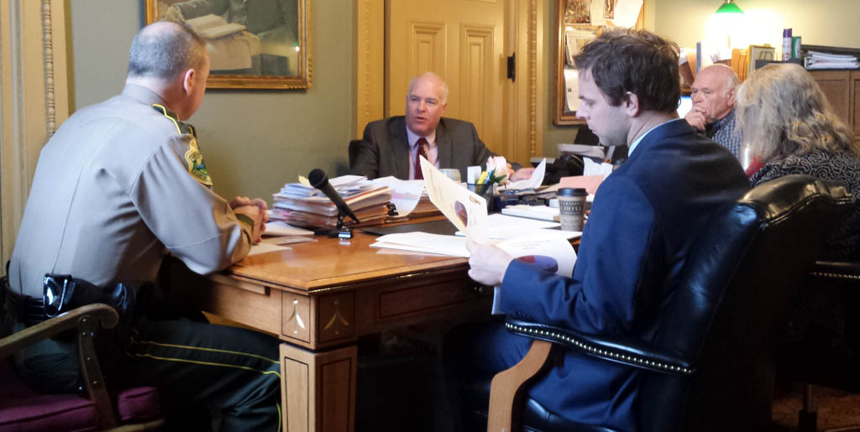
Policymaking 101: Context for the Work of the Legislature
Describe 3 strategies you use when dealing with people in a hurry. Think about a time when you succeeded and did not succeed in conveying a message.

Slide 10
Policymaking 101: The Bill Consideration Process

Slide 11
“Successful connections with legislators rely on
repeated, quality interactions,
on the legislators’ own terms, at times when the legislators are most approachable.”

Slide 12
Advocacy 101: Effective Citizen Advocacy – Getting Started
Get started by first asking yourself:
What is my issue? Who else is working on the issue?
What is my role? What “expertise” do I offer legislators?
What is my action plan? How can I spend time in the State House, see legislators at community events or communicate with them electronically?

Slide 13
Advocacy 101: Moving along the Spectrum of Engagement from “Constituent” to “Advocate”
NEW | JUST A BIT | ACTIVELY INVOLVED | SPOKEN OUT | BECOME A RESOURCE
“I’ve never advocated before.” | “I’ve left a message for my legislator or signed a petition on an issue.” | “I’ve submitted comments on an Administrative program or a bill, or attended Early Childhood Day at the Legislature.” | “I’ve met directly with my legislator on an issue or testified in a committee hearing.” | “I’ve monitored an issue in the State House by attending Legislative Committee meetings and working with lobbyists.”
Constituent Advocate

Slide 14
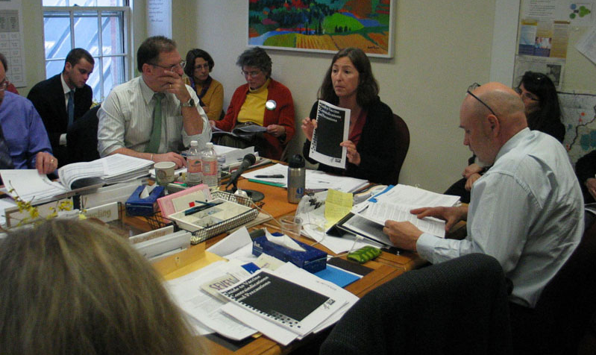
Advocacy 102: Beyond “Lobby Day” – Building Long Term Relationships
Many successful citizen engagement efforts rely on quality interactions with legislators, not quantity.
They build on pre-existing relationships, developed over time in the State House and in the community.
Spending time in the State House, at events where legislators are present, and/or communicating with them electronically is critical.

Slide 15
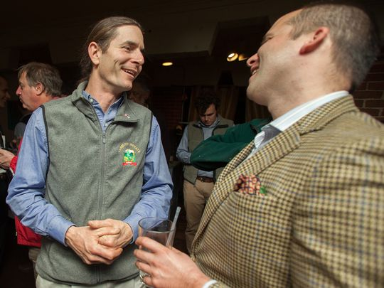
Advocacy 102: Identify “Your” Legislator
Building relationships where the legislator sees an advocate as an expert on the issue and feels accountable for their decisions makes interactions much more effective.
Often the most valuable relationships are between advocates and relevant legislators on committees of jurisdiction, leadership, etc. – not simply the legislators for whom the advocate is a constituent.

Slide 16
Advocacy 102: Effective Citizen Advocacy – 3 Key Phrases
“Pleasant, Patient, Persistent” – then repeat …
“Compelling, not comprehensive”
“It’s a team sport!”

Slide 17
Looking Ahead to 2017: Relationships are Built in the Community
Several opportunities to connect with policymakers or take action
Contact my legislators or the Governor Ask Select Board members for support
Write to the Agency that regulates/manages this issue Ask my professional group for support
Bring the issues to my church, synagogue, or other group
Write a Letter to the Editor or call a “talk radio” show
Join one or several of the groups working to help Vermont’s children
Places you might see legislators in your community
Town Meeting Day Ribbon cutting or open house
Local business (coffee shop, etc.) State House
Local sports/school event Local Political Cmte. Meeting
Select board, School board, or other government meeting Chamber/Professional meeting

Slide 18
Looking Ahead to 2017: Tactics and Techniques
How can we work together in taking action on an issue? We can:
Connect your interest to issues on the 2017 Legislative Agenda and to the other organizations or individuals working on the issue.
Design a plan for your relationship-building with legislators and how we can support you as you increase your comfort level through ongoing contacts on the issue, as part of a larger team.

Slide 19
We’re Here for You – Please Be in Touch!
Matt Levin Kelly Ault
Executive Director Public Engagement Director
802-229-4281 802-272-0795
matt@vteca.org kelly@vteca.org
Sign up to get Alliance email alerts, or to become an individual member, at our website.
vermontearlychildhoodalliance.org * 802-229-4281 * a program of the VT Community Loan Fund

