Slide 1




Dried Beans or Dried Cranberries: Taking the Mystery Out of USDA Foods
Rosie Krueger
Vermont Child Nutrition Programs

Slide 2
Why USDA Foods?
Foods purchased by the Federal Government
  Support American agriculture by removing surplus from markets
    USDA Foods are 100% American grown and processed
  Provide nutritious foods to populations in need:
    School Nutrition Programs
    Commodity Supplemental Food Program (CSFP)
    The Food Distribution Program on Indian Reservations (FDPIR)
    The Emergency Food Assistance Program (TEFAP)
Notes:
Origins during the Great Depression. Farmers were burning crops that they couldn’t sell, while many Americans were going hungry. The Federal Government began buying the surplus crops and distributing them to the hungry.

Slide 3
TEFAP USDA Foods In Vermont
Administered by VT Agency of Education, Child Nutrition Programs
  Grant funds to the Vermont Foodbank to warehouse and distribute the foods
  State and Foodbank staff work together to select entitlement foods and decide whether to accept bonus foods
  USDA purchases foods through a formal procurement process
  Foods arrive at the VT Foodbank’s warehouses in full truck loads of a single item
VT Foodbank allocates foods out to food pantries and congregate feeding sites
  Food pantries distribute foods to eligible households
    Eligible Households = Earn less than 185% of Federal Poverty Level & live in the Sate of Vermont
    Recipients sign statement saying they are eligible
  Congregate Feeding Sites use USDA Foods to prepare meals
    No requirements for individuals who receive prepared meals at a congregate feeding site.
Notes:
The regulations require that the Vermont Foodbank monitor all of your sites every year, and that someone from the state agency – the Vermont Agency of Education – visits 10% of the sites per year.

Slide 4

Entitlement vs. Bonus Foods
Entitlement USDA Foods
  Foods and delivery dates selected by the State and the VT Foodbank from a catalog of available foods
  Each product has an entitlement “cost”
  Vermont is entitled to receive $405,896 worth of entitlement foods during 2016
Bonus USDA Foods
  Purchased by USDA to clear market surpluses
  Specific items and delivery dates are chosen by USDA
  Foods are fair-shared to all 50 states and 5 territories
  State can “take it or leave it” – we try to always take it!
  Sometimes cancelled at the last minute if market conditions change
  Vermont will receive about $875,000 worth of bonus foods during 2016

Slide 5
2016 USDA Foods for Vermont
January:
Chicken Quarters (B)
Apple Juice (B)
Canned Salmon (B)
Raisins (B)
Dried Cranberries (B)
February:
Chicken Quarters (B)
Orange Juice (B)
Cranberry Juice (B)
Cranberry Sauce (B)
March:
Chicken Quarters (B)
Orange Juice (B)
Dried Cranberries (B)
Russet Potatoes (E)
April:
Chicken Quarters (B)
Cranberry Juice (B)
Applesauce Cups (E)
Great Northern Beans (B)
May:
Chicken Quarters (B)
Catfish Fillets (B)
Walnut Pieces (B)
June:
Chicken Quarters (B)
Milk 1% (E)
July:
Spaghetti Sauce (E)
Spaghetti (E)
Corn Flakes (E)
Catfish Fillets (B)
August:
Walnut Pieces (B)
Macaroni (E)
Ham (E)
Grape Fruit Juice (B)
Canned Cherries (B)
September:
Dry Pinto Beans (B)
Rolled Oats (E)
Milk 1% (E)
Beef Stew (E)
Dried Cherries (B)
October:
Canned Corn (E)
Peanut Butter (B)
Eggs, Whole (E)
Cereal, Rice Crisp (E)
Canned Cherries (B)
November:
Empire Apples (E)
Vegetable Soup (E)
Canned Mixed Fruit (E)
Spaghetti (E)
Spaghetti Sauce (E)
December:
Milk 1% (E)
Cereal, Shredded Wheat (E)
Grape Fruit Juice (B)
Orange = Entitlement (E)
Green = Bonus (B)
Notes:
This year we had a lot of bonus items for the first part of the year, so we saved most of our entitlement spending for the second half of the year. Generally, we are able to stretch our entitlement to about 2 items per month over the whole year.
Bonus chicken from Avian Flu – not because chickens had the flu, but because many countries refused our exports of chicken while the Avian Flu was active, so there was a surplus on the market. These are not infected chickens!

Slide 6
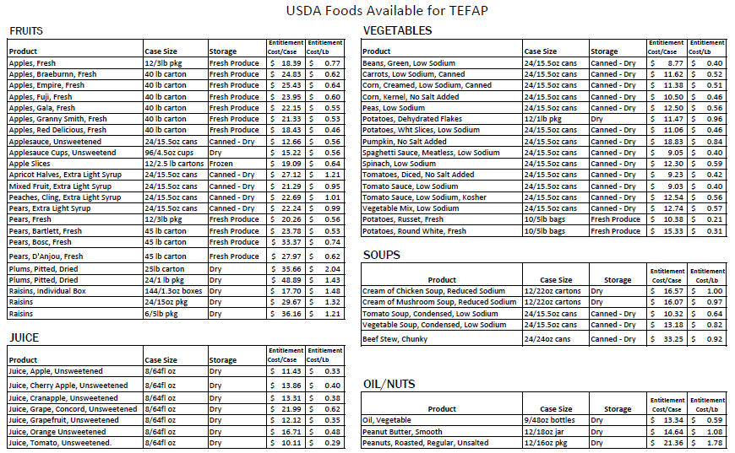
Orange = Entitlement (E)
Green = Bonus (B)

Slide 7
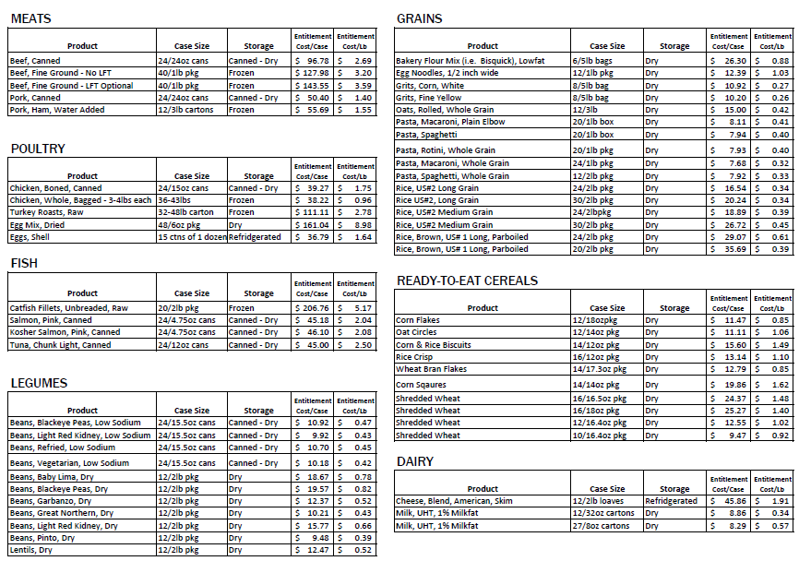

Slide 8
Selecting Entitlement Foods
How can we improve our Strategy?
One option: Choose just a few items to always have available
  Examples: Milk, Cereal, Pasta, Tomato Sauce, Eggs
  Or is variety important?
Are there key foods that you can never get enough of?
How do we feel about spending entitlement on produce and meat/frozen items?
Should we focus on “healthy” foods or foods that recipients request?
  Whole Grain Pasta vs. White Pasta
Should we convene an advisory group or send out a survey to all participating food pantries to help select foods?
  Other methods of selecting foods?

Slide 9
Program Paperwork
Agencies receiving TEFAP Foods must keep the following records:
  Statement of Eligibility for each person receiving USDA Foods
    Signed each time recipient receives foods
  Monthly Distribution Report
    Foods on hand at beginning of month
    Foods received (from Foodbank)
    Foods distributed
    Foods on hand at end of month
  Annual Agreement with the Vermont Foodbank
All Records must be kept for 3 years, plus current year
Notes:
(3) Household information. Each distribution site must collect and maintain on record for each household receiving TEFAP commodities for home consumption, the name of the household member receiving commodities, the address of the household (to the extent practicable), the number of persons in the household, and the basis for determining that the household is eligible to receive commodities for home consumption. 7CFR 251.10(a)(3)

Slide 10
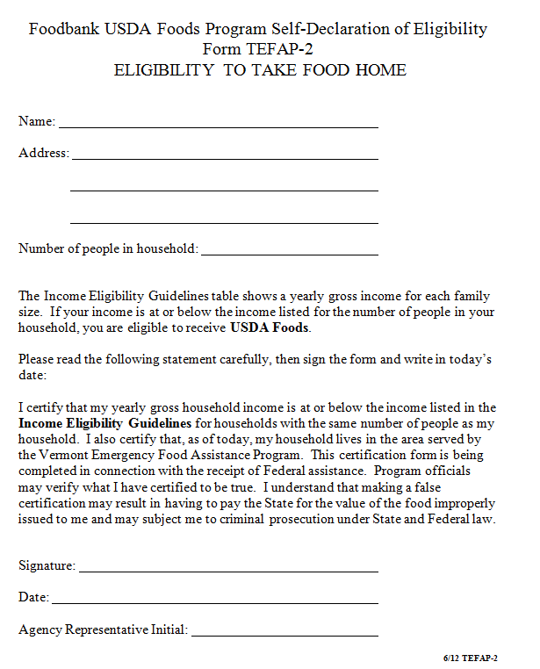
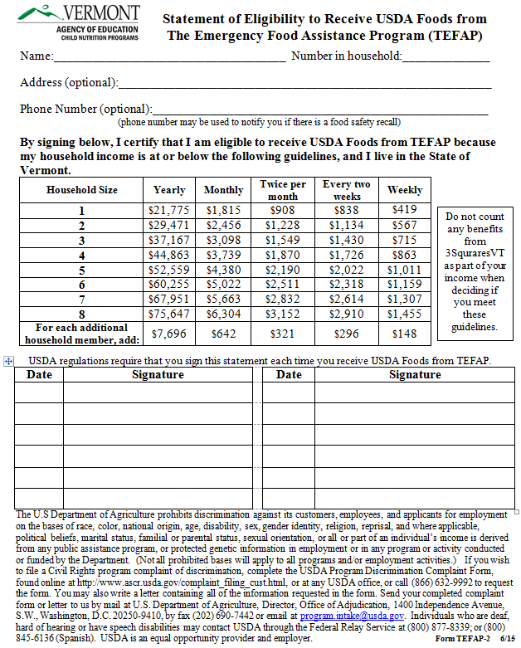
Old Form
Current Form
Notes:
The Code of Federal Regulations requires that recipients of USDA Foods for household distribution attest that they meet the income requirements and residency requirements before receiving USDA Foods. We used to handle that by having recipients sign the form on the left once a year. However, several years ago, USDA advised us that they interpret the regulation as requiring the recipients attestation every single time they receive USDA Foods. We first addressed this by requiring recipients to sign the form on the left every single time, or by requiring them to sign the form on the left once a year, and a sign-in sheet that doubled as re-attesting every single time. This was confusing. In addition, the old form included some language saying that the program officials might verify the information, and that the recipient could be subject to criminal prosecution if they lied on the form – this is also not true. So last year, we re-designed the form to remove the scary and false legal stuff, and to make it easier to have recipients sign every single time. We had some push back on this, and a couple of agencies decided to stop receiving USDA Foods because they didn’t like the paperwork change. There’s not much we can do about the federal interpretation that the attestation needs to be signed every time the foods are received – we have to do that to continue receiving USDA Foods. But we can certainly make changes to the form we use to collect that information, if you feel that it is confusing to recipients.
Go through new form.
12 signature lines, but does not limit number of times recipient can receive foods – can just attach a second page.

Slide 11
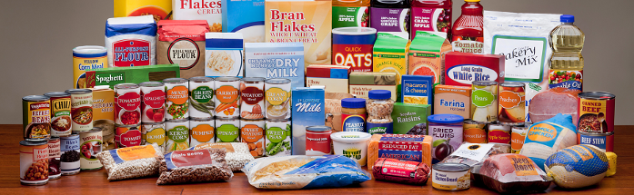
Program Administration
How can we Improve?
Changes that you would like to see to the eligibility form?
Vermont sets the income requirements at 185% of the federal poverty level
  Is that level too low for any of your recipients?
  Should we consider increasing that income threshold?
Image: http://www.fns.usda.gov/tefap/emergency-food-assistance-program-tefap
Notes:
(3) Household information. Each distribution site must collect and maintain on record for each household receiving TEFAP commodities for home consumption, the name of the household member receiving commodities, the address of the household (to the extent practicable), the number of persons in the household, and the basis for determining that the household is eligible to receive commodities for home consumption. 7CFR 251.10(a)(3)

Slide 12
How Can You Distribute USDA Foods?
Distribute to eligible clients
  No federal or state restrictions on how often or how much you can distribute to each client
  Clients do need to attest each time that they meet the program requirements
Use to prepare meals for congregate feeding
  Anyone can eat – no income restrictions or paperwork needed.

Slide 13
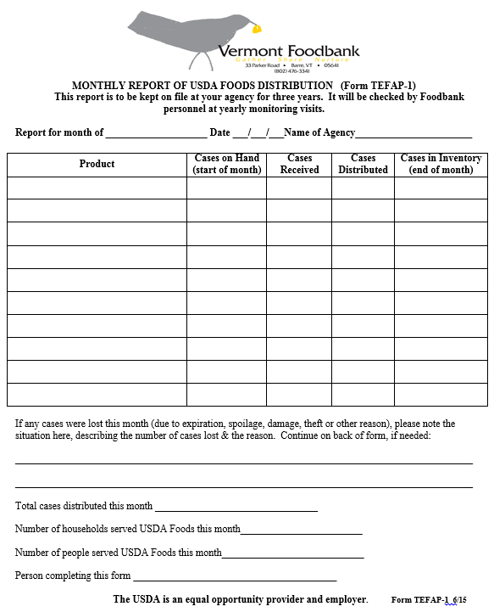
Inventory Control
Request more if you can use it
Decline items that don’t move quickly
Don’t stockpile food
Forward product complaints to the Vermont Foodbank
  Include photos, lot numbers and delivery dates if possible
Notes:
If something isn’t moving, think about how to make it more appealing to clients.
Ideas that have worked:
Refrigerating the shelf-stable milk, even though it doesn’t need it, makes it feel like normal milk
Have samples available for tasting
Hand out simple recipes using the item (see fact sheets for ideas)

Slide 14
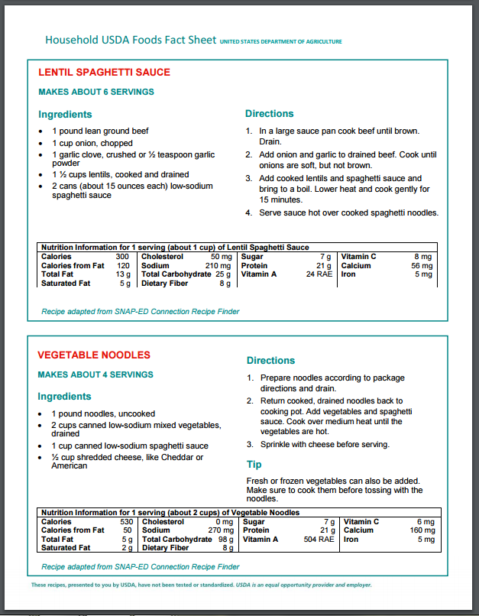
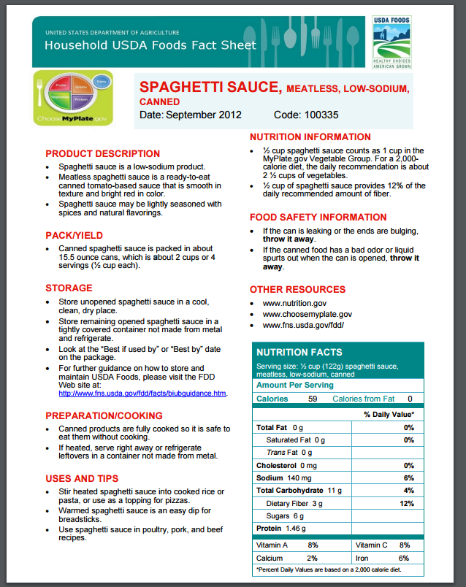
USDA Foods Factsheets
Fact Sheets for most USDA Foods are available at:
http://www.whatscooking.fns.usda.gov/fdd/household-material-fact-sheets

Slide 15
Contact Information
Rosie Krueger
VT Agency of Education, Child Nutrition Programs
Phone: 802-479-1246
Email: mary.krueger@vermont.gov
Joe Dauscher
Vermont Foodbank
Phone: 802-477-4106
Email: jdauscher@vtfoodbank.org
Bonnie Pease
Vermont Foodbank
Phone: 802-477-4112
Email: bpease@vtfoodbank.org

